Slide 1
Managing the Project Team
By Matthew Kennedy

Slide 2

What is Team Management?
Team Management looks at how an individual or an organisation is able to bring together and coordinate a group of individuals in order to perform a task.
Creating good teamwork and communication
Identifying and solving problems.

Slide 3

Why do we need Team Management?
People are the Greatest Assets.
Costs a lot to recruit and retain good people
Project Managers get the best out of people when they are respected by their organization and are assigned responsibilities that reflect their skills and experience.

Slide 4

Getting the right people
Creating a group with people with the right balance of technical expertise and character can be a difficult task.
Project managers should look to create groups that contain a mix of people as software projects will have a multitude of different activities to do like client negotiation, programming and testing.

Slide 5
Personality Types (Bass and Dunteman)(1963))
Task-Oriented - motivated by the work itself;
Self-Oriented - motivated by personal success;
Interaction-oriented - motivated by the presence and actions of co-workers;

Slide 6

Difficulties with Motivation.
It’s not always possible to achieve this
Project Managers will need to step in and control the group so they are meeting the group objectives.
Easier to achieve when all group members take part in all stages of the project.

Slide 7
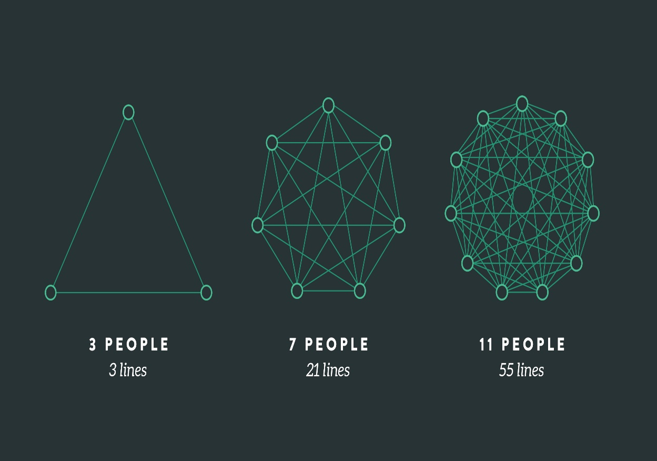
Other Basic Principles
Reasonable group size for lines of communication
Have multiple ways of communicating
Establish an appropriate structure

Slide 8
Common Pitfall – Brooks’ Law
"adding human resources to a late software project makes it later“
Theory: more people ⇒ better work rate
More severe problems

Slide 9
References
https://en.wikipedia.org/wiki/Brooks%27s_law
https://edisciplinas.usp.br/pluginfile.php/2150022/mod_resource/content/1/1429431793.203Software%20Engineering%20by%20Somerville.pdf
http://www.cs.unc.edu/~stotts/145/peopletypes.html
https://en.wikipedia.org/wiki/Team_management

